Slide 1
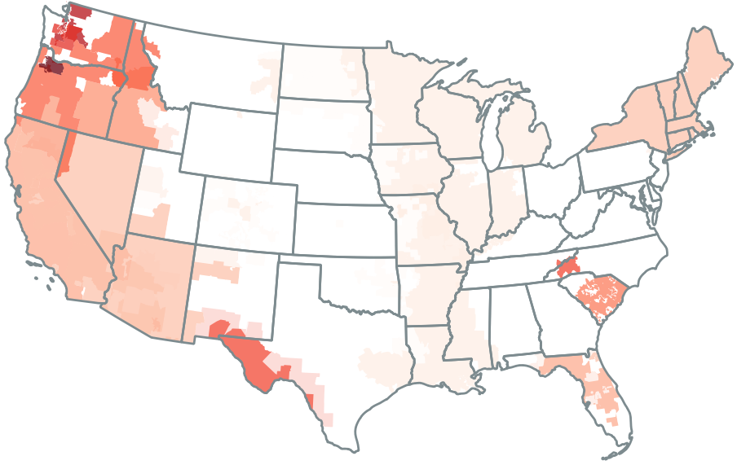
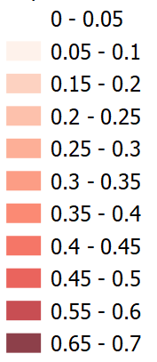
FIGURE: Import reliance as a share of total energy by U.S. Balancing Authority, 2016-2023

Slide 2
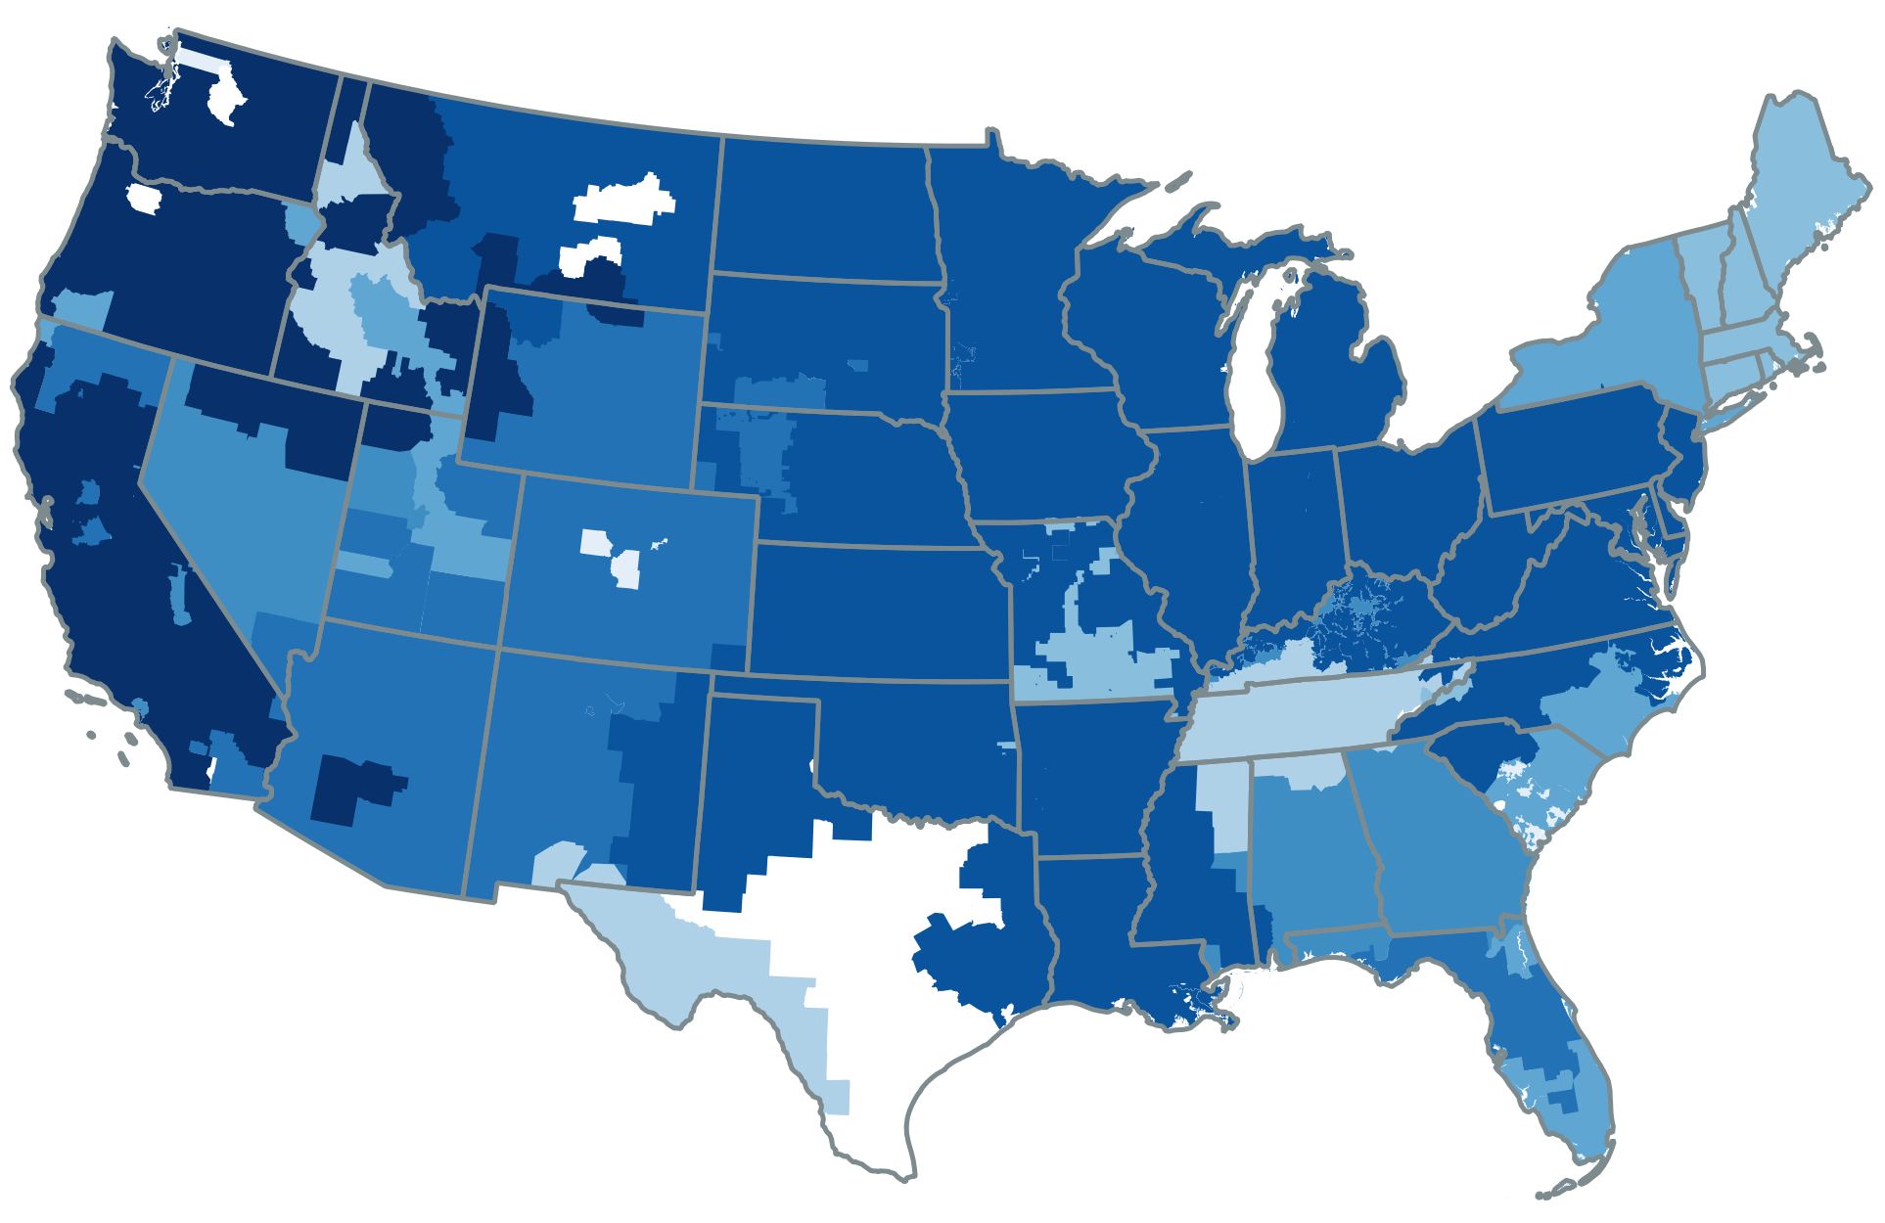
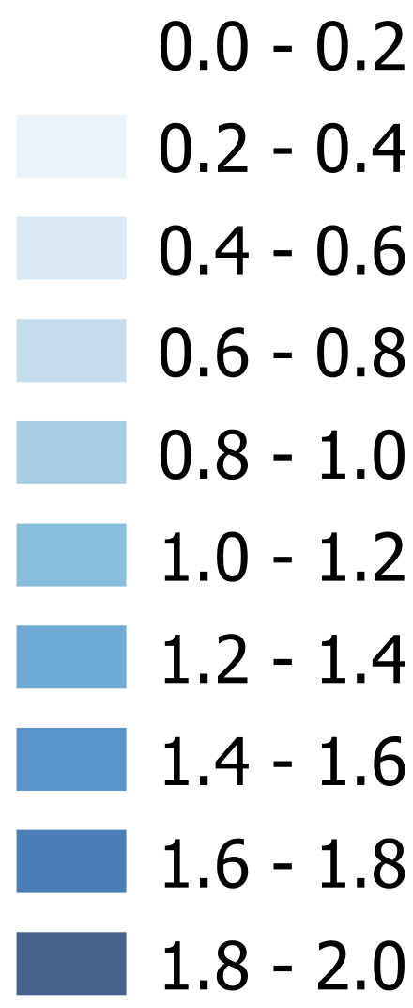
FIGURE: Import diversity metric by U.S. Balancing Authority, 2016-2023

Slide 3
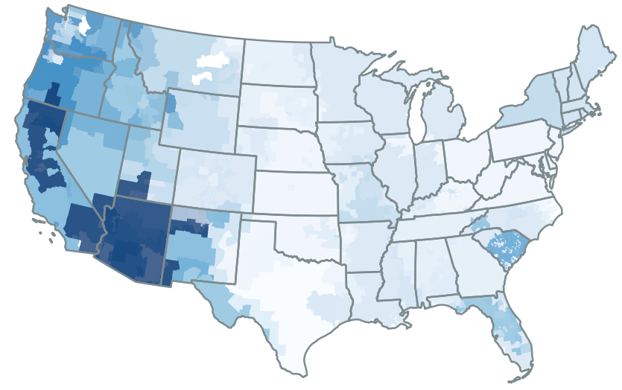

FIGURE: Import diversity metric by U.S. Balancing Authority, 2016-2023

Slide 4
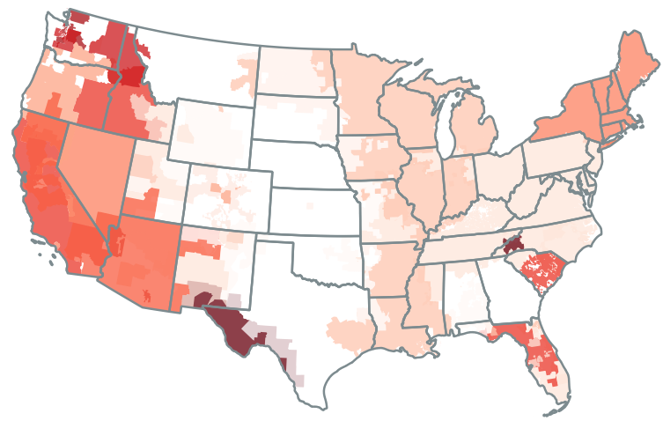
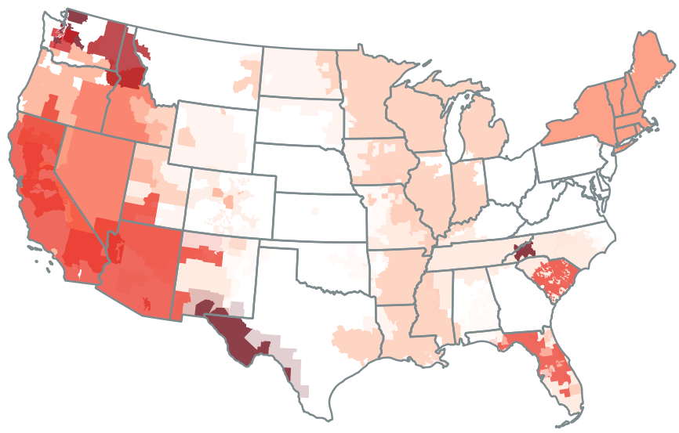
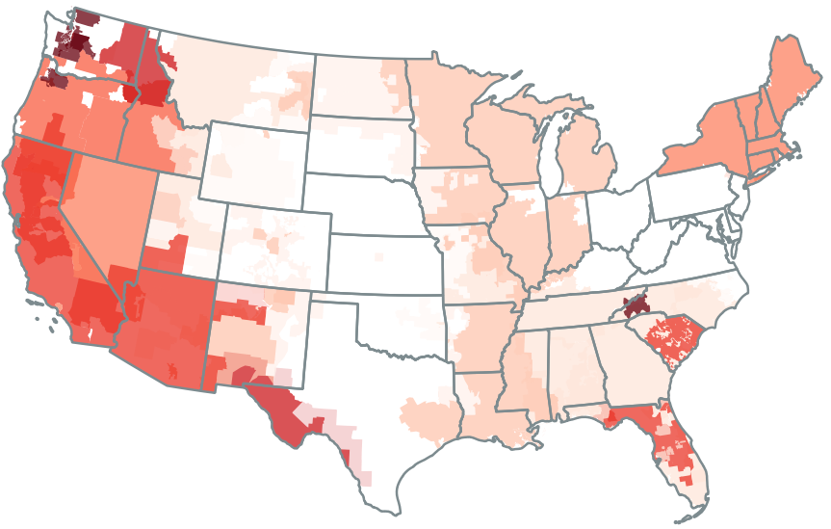
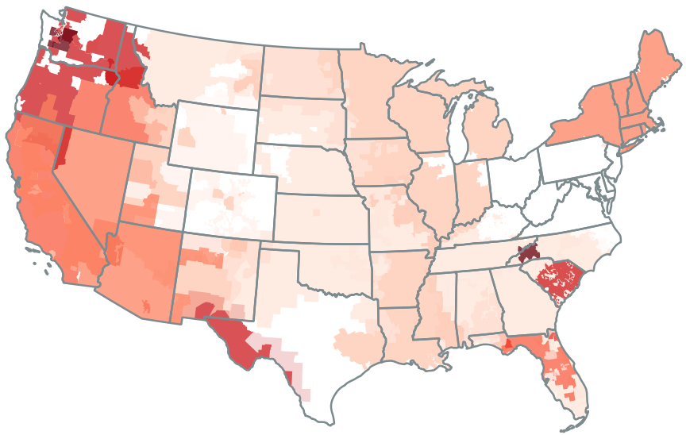
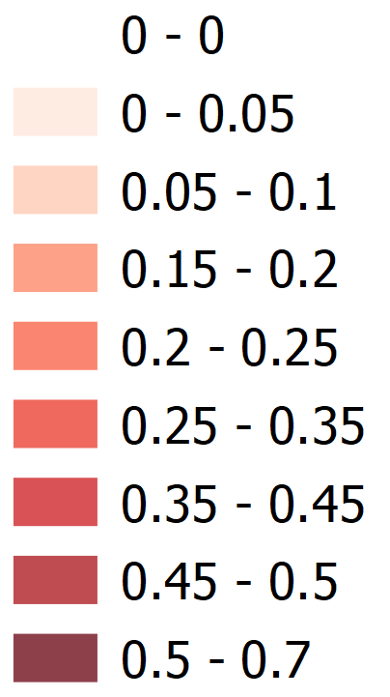
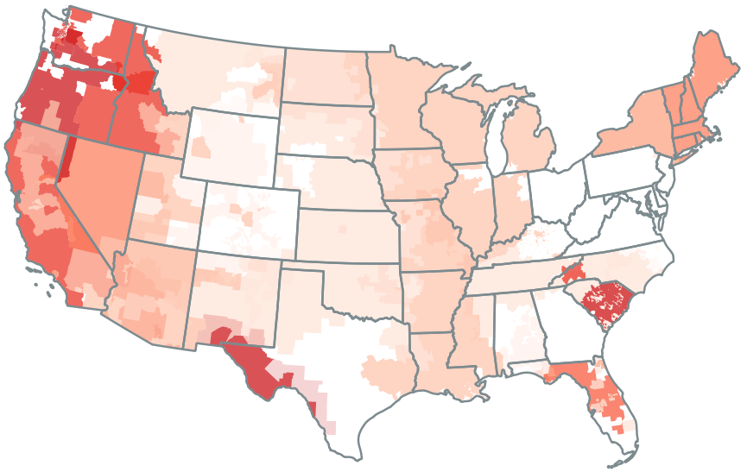

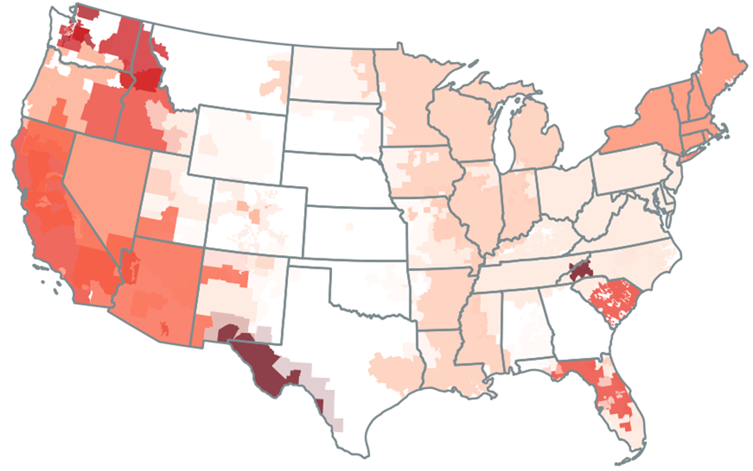

2016
2017
2018
2019
2020
2021
2022
2023

Slide 5
2016

Slide 6
2017

Slide 7
2018

Slide 8
2019

Slide 9
2020

Slide 10

2021

Slide 11

2022

Slide 12

2023

